Slide 1
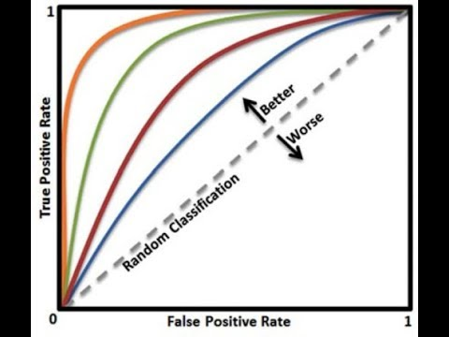
Model Comparision
Evaluation Metrics
Baseline Model:
Logistic Regression
Accuracy
ROC_AUC
Notes:
We used accuracy and ROC_AUC(Area under the ROC Curve) as evaluation metrics. Since we have unbalanced target label, it is better use ROC_AUC. Higher the AUC, better the model is at distinguishing between label 0 and label 1.
After feature engineering, we selected top 150 most important features and tried logistic regression as our baseline model. We got Valid AUC at 0.7610.

Slide 2
Model Comparision
Model Comparation
RandomizedSearchCV:
Notes:
In phase 2, to compare model performance, we did randomized search to find a first impression of selected models.
From the RandomSearch of 1% of the data, we run 5 models and hyperparameter tunning. As the table shown above, XGBClassifier with parameters [colsample_bytree=0.8, gamma=1, max_depth=4, min_child_weight=1, subsample=0.6] has the best performance with train AUC 0.7287. Following XGB Classifier, Gradient Boosting, Stochastic Gradient Descent and Random Forest are also potential candidate. So we did grid search for those models to find the best.

Slide 3
Model Comparision
GridSearchCV
Notes:
After grid search with 20% of data, we found XGB is the best model ,with parameters as following: colsample_bytree: 0.6, gamma: 1.5, max_depth: 3, min_child_weight: 5, subsample: 0.6. with p-value = 0, we can say XGB is significantly different with the baseline model (Logistic Regression).

Slide 4
CatBoost
Model Comparision
Notes:
Catboost is a gradient boosting algorithm, in phase 3, we found CatBoost outperforms other model. With the most recent 328 features, we got Valid AUC at 0.7835. Since we hot encoded categorical feature before feeding data into CatBoost, we did not specify categorical features for Catboost. The lower part of the log showed experiments we did for comparing different models with 297 new features (without adding imputation by median pipeline)

Slide 5
Deep Learning
Model Comparision
Notes:
We experimented on different deep learning models. By adjusting input features, hidden layer numbers, optimizer and batch size, we did more than 30 experiments in total, the best valid AUC is 0.7660 with input dimention 150, hidden layer 32-16-8 and adagrad as optimizer.

Slide 6
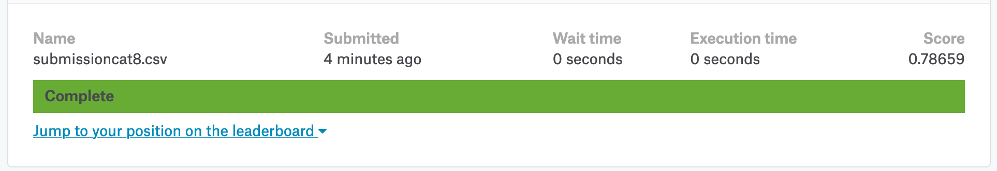
Kaggle Score:
Kaggle Score
Phase 1: 60 Features, Logistic Regression
Phase 2: 150 Features, XGBoost
Phase 3: 328 Features, CatBoost
Rank: 3518
Notes:
In Phase 1, with hand delected 60 features and logistic regression, we got Kaggle score at 0.75252.
In phase 2, we added some new features, added iterative imputer pipeline for top 4 most correlated features with 'EXT_SOURCE_3’, and conducted feature selection by random forest most important features. With top 150 most important features, XGB performed best with Kaggle score 0.76216.
Phase 3, we added even more new features and added imputater pipeline for selected features and imputed them by ‘median’. We also found CatBoost outperformed XGBoost. With CatBoost, Kaggle score increased up to 0.78659.

